Slide 1

Data Lifecycle Management

Slide 2
Know your data
Protect your data
Prevent data loss
Govern your data
Understand your data landscape and identify important data across your hybrid environment.
Apply flexible protection action including encryptions, access restrictions and visual markings.
Detect risky behavior and prevent accidental oversharing of Sensitive information.
Automatically retain delete and store data and records in a compliant manner.

Slide 3
Data Lifecycle Management
Action
Retain Content
Delete Content
Purpose
Prevent permanent deletion and remain available for eDiscovery
Permanently delete content from your organization
Notes:
Retain-only: Retain content forever or for a specified period of time.
Delete-only: Permanently delete content after a specified period of time.
Retain and then delete: Retain content for a specified period of time and then permanently delete it.
How retention settings work with content in place
When content has retention settings assigned to it, that content remains in its original location. Most of the time, people continue to work with their documents or mail as if nothing's changed. But if they edit or delete content that's included in the retention policy, a copy of the content is automatically retained.
For SharePoint and OneDrive sites: The copy is retained in the Preservation Hold library.
For Exchange mailboxes: The copy is retained in the Recoverable Items folder.
For Teams, Viva Engage messages, and interactions with Microsoft Copilot for Microsoft 365: The copy is retained in a hidden folder named SubstrateHolds as a subfolder in the Exchange Recoverable Items folder.

Slide 4
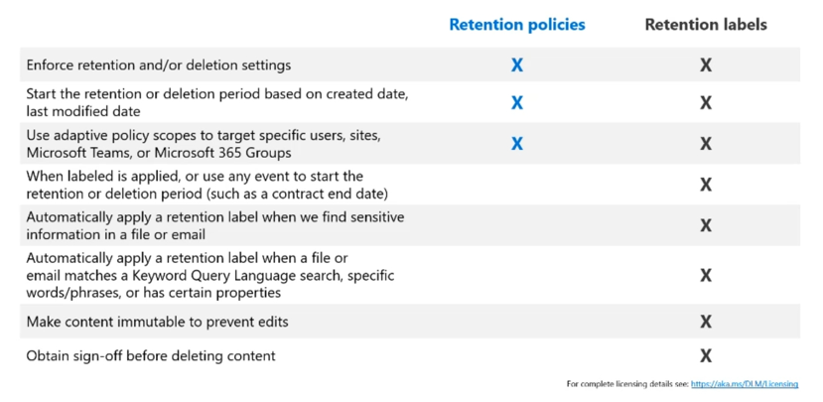
Data Lifecycle Management: Retention Policy and retention labels

Slide 5
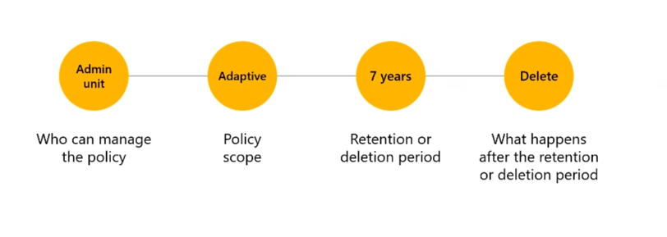
Data Lifecycle Management: Settings for Retention policies

Slide 6
Create Retention policy
Notes:
Create a retention policy in Microsoft Purview (cloudguides.com)
https://aka.ms/DLM/Guide

Slide 7
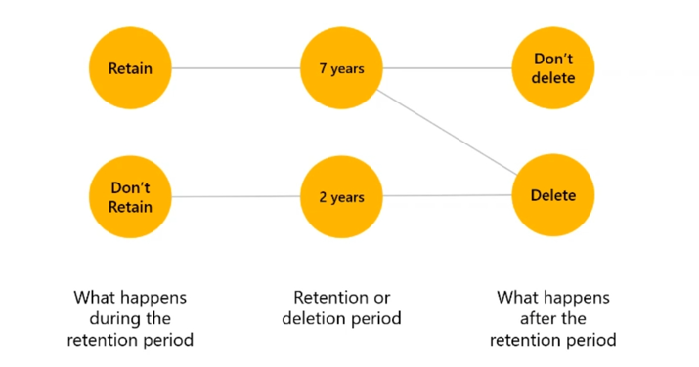
Data Lifecycle Management: Settings for Retention labels

Slide 8
Create Retention label and apply a retention label in M365 – Auto Apply
Manage disposition reviews
Notes:
Apply a retention label in Microsoft Purview (cloudguides.com)
Manage disposition reviews in Microsoft Purview (cloudguides.com)
https://aka.ms/DLM/Guide

Slide 9
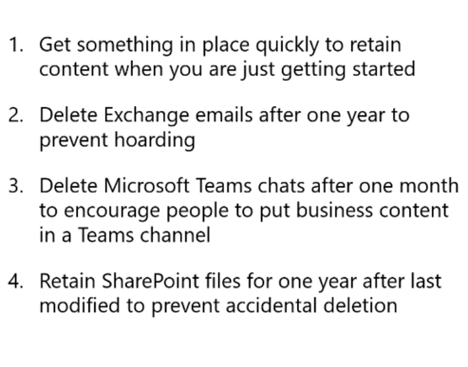
Data Lifecycle Management: Real life examples of retention polices

Slide 10
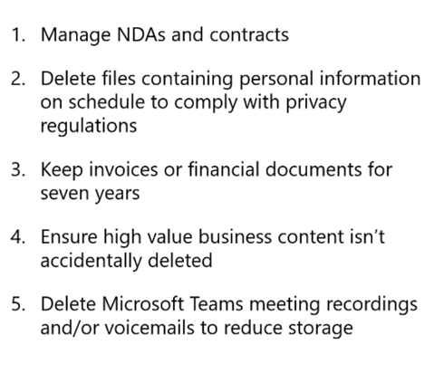
Data Lifecycle Management: Real life examples of retention labels

Slide 11
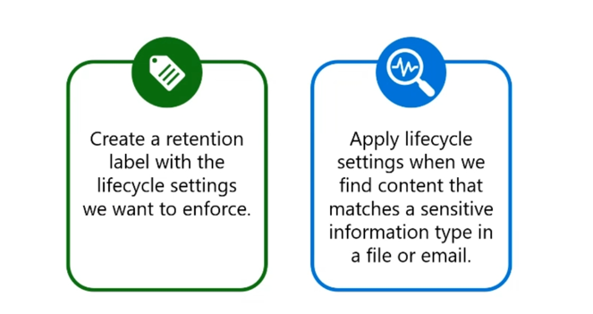
Data Lifecycle Management: Auto apply to content containing sensitive data

Slide 12
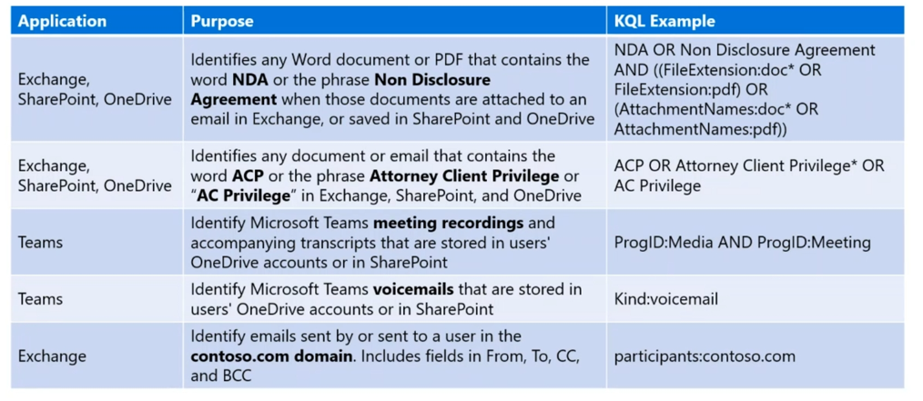
Data Lifecycle Management:
Query-based auto-apply
Notes:
Show demo with teams transcript

Slide 13
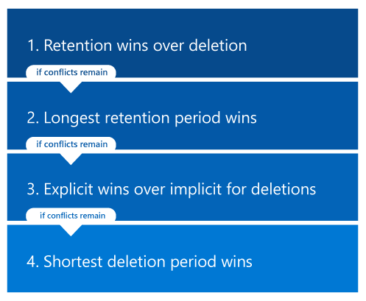
The principles of retention, or what takes precedence?
Notes:
With retention labels you can only apply ones per file, you can apply more than one retention policy to the same content. Each retention policy can result in a retain action and a delete action. Additionally, that item could also be subject to these actions from a retention label.
In this scenario, when items can be subject to multiple retention settings that could conflict with one another, what takes precedence to determine the outcome?
The outcome isn't which single retention policy or single retention label wins, but how long an item is retained (if applicable) and when an item is deleted (if applicable).
These two actions are calculated independently from each other, from all the retention settings applied to an item.
For example, an item might be subject to one retention policy that is configured for a delete-only action, and another retention policy that is configured to retain and then delete.
Consequently, this item has just one retain action but two delete actions. The retention and deletion actions could be in conflict with one another and the two deletion actions might have a conflicting date. The principles of retention explain the outcome.
At a high level, you can be assured that retention always takes precedence over permanent deletion,
and the longest retention period wins.
These two simple rules always decide how long an item will be retained.
There are a few more factors that determine when an item will be permanently deleted, which include the delete action from a retention label always takes precedence over the delete action from a retention policy.
Use the following flow to understand the retention and deletion outcomes for a single item, where each level acts as a tie-breaker for conflicts, from top to bottom. If the outcome is determined by the first level because there are no further conflicts, there's no need to progress to the next level, and so on.
https://learn.microsoft.com/en-us/purview/retention?view=o365-worldwide&tabs=table-overriden#the-principles-of-retention-or-what-takes-precedence

Slide 14
Data Lifecycle Management
(Training and Documentation)
Ninja Training
https://aka.ms/DLM/Ninjatraining
Documentation
https://aka.ms/DLM/Documentation
Licensing information
https://aka.ms/DLM/Licensing

